Slide 1
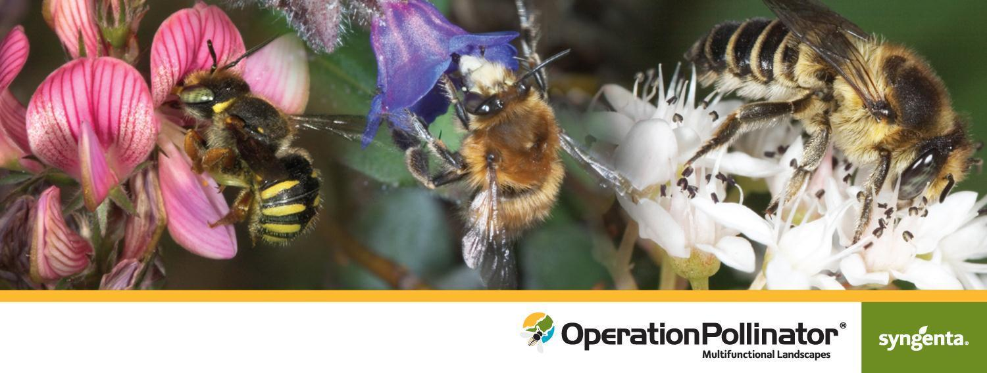
Positive Action
for Pollinators in the Golf Industry
Unlocking Golf’s True Potential

Slide 2
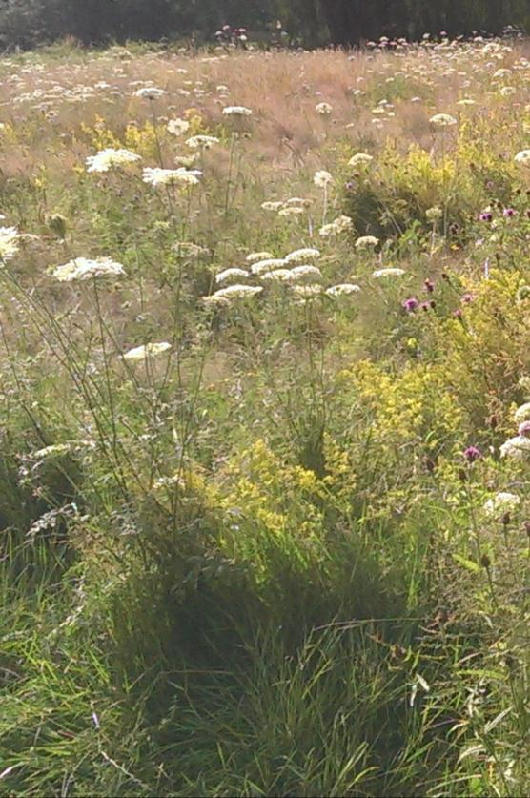
What is Operation Pollinator?
Global initiative that began in Europe, expanding into the US
Based on scientific research
Operation Pollinator - feeding bees & protecting the environment for over 10 years

Slide 3
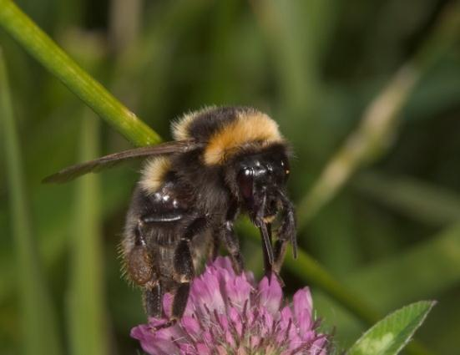
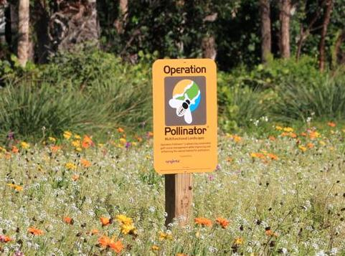
New Initiative for Golf Key Objectives:
Play a key role in reviving the fortunes of native bees and other pollinating insects
Generate positive coverage for golf clubs and the golf industry
Introduce native wildflowers to attract bees and other pollinating insects to out-of-play areas of the golf course

Slide 4
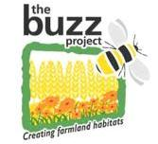
A Successful Project
Scientific Project
2001-2005
Roll-out across Europe
2009-2014
Roll-out in U.S.
2011- Present
Increased bumblebee numbers up to 600% over crop
Regeneration of the rare Bombus ruderatus
Butterflies rose 12 fold
Other pollinating insects rose 10 fold
Already 16 countries joined
Partnerships with governments, universities, food chain, etc.
Evaluate and develop recommendations for native wildflower seed mixes
Six sites on Ky. golf courses and the University of Kentucky A.J. Powell, Jr. Turfgrass Research Center
14 sites have been established on Marriott Golf-managed properties

Slide 5
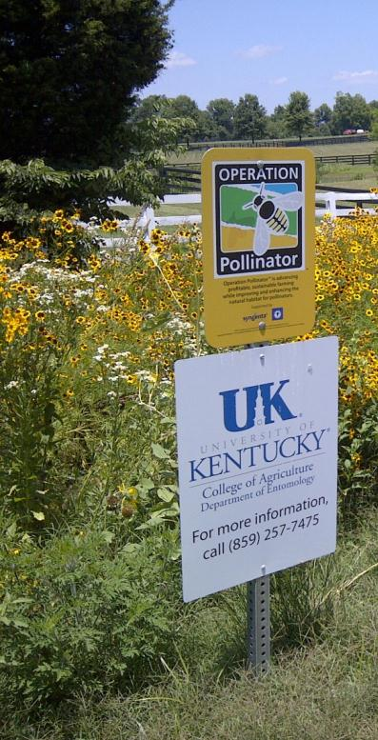
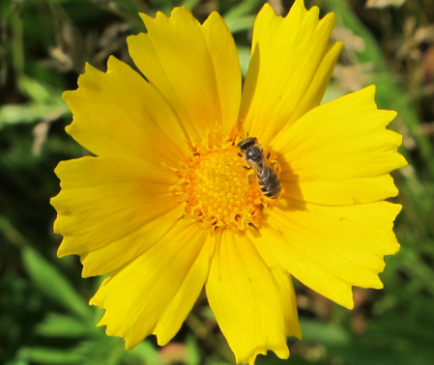
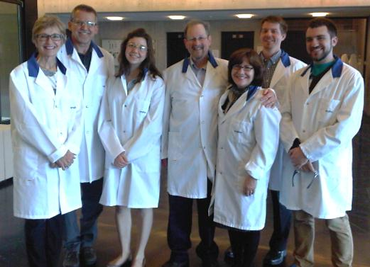
Operation Pollinator at the University of Kentucky
Dr. Daniel Potter, turfgrass entomologist and Emily Dobbs, graduate student.
Six sites in the greater Lexington, Ky. area, including five golf courses and the University of Kentucky Turfgrass Research Center.
Establishment in September 2011, pollinators surveys and wildflower evaluation in 2012 and 2013.

Slide 6
Who Benefits from Operation Pollinator?
Unlocking Golf’s True Potential

Slide 7
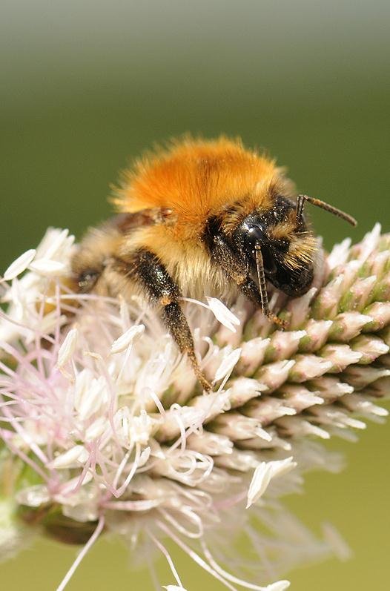
Benefits for Everyone
Pollinators
Superintendents
Players
Community
Golf Club

Slide 8
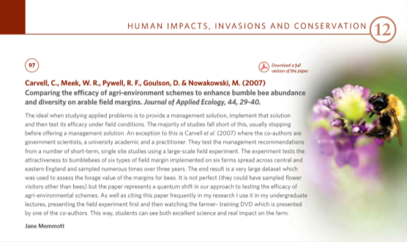
Bees are Important
70% decline in bumblebees over 40 years
Bees help pollinate 35% of our crops
Top 100 BES influential papers
“A golf course which is not abuzz with color and movement is a sad and lonely place.”
Paul Worster, Minchinhampton Golf Club
Bees play a vital role in our agricultural system, making the care and protection of bees critical to the future of our planet’s food security

Slide 9
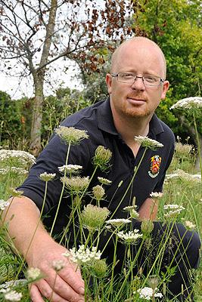
Benefits for Everyone
Pollinators
Superintendents
Players
Community
Golf Club

Slide 10
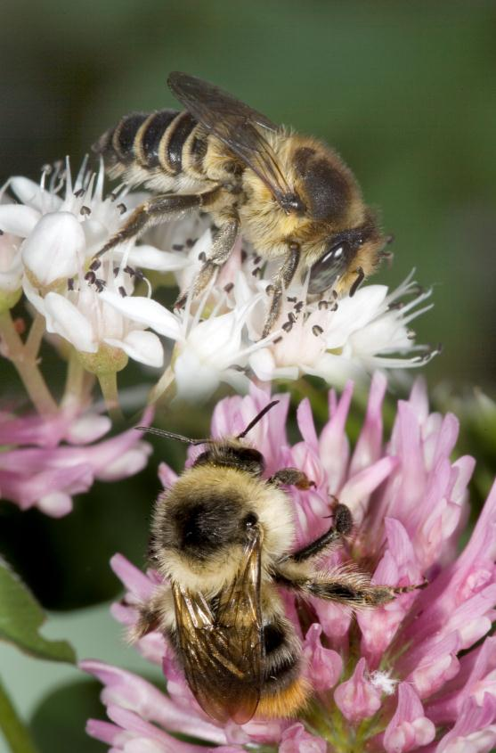
Raising your Profile
Raising the profile of your team
A sense of pride and motivation
Promote good management practice
Greater engagement with club members
Building environmental management skills
Recognition through environmental awards

Slide 11
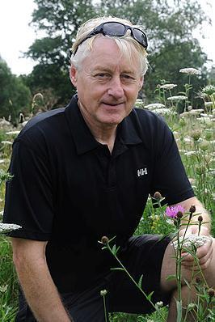
Benefits for Everyone
Pollinators
Superintendents
Players
Community
Golf Club

Slide 12
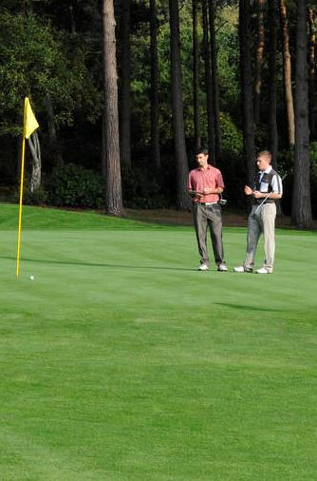
Enhancing the Playing Experience
81% of players surveyed said that it is important to have a natural-looking course
74% of players agree or strongly agree with the statement “I enjoy seeing wildlife, birds, bees and butterflies when I play”
60% are not satisfied with environmental initiatives on the course

Slide 13
Benefits for Everyone
Pollinators
Superintendents
Players
Community
Club

Slide 14
Unlocking the Club’s True Potential
“Every business needs as many key selling points as possible, and Operation Pollinator is a great opportunity to show the best side of golf in action!”
Paul Worcester, Minchinhampton Golf Club
Raise the profile
Creating pride and interest
Attract new members
Retain current members
Attract more visitors
Environmental accreditation
Marketing opportunity

Slide 15
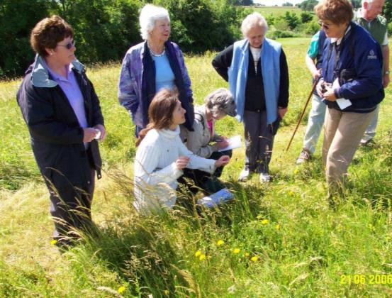
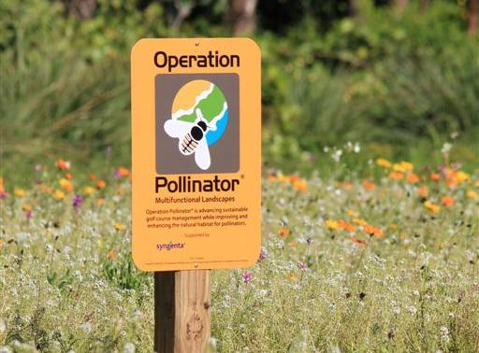
Objectives
Pollinators
Superintendents
Players
Community
Golf Club

Slide 16
Connect with the Community
Invite local schools to get involved with management and monitoring
Engage with local environmental groups
Open days/course walks
Breakfast meetings or educational seminars

Slide 17
Bringing your Golf Course to Life
Unlocking Golf’s True Potential

Slide 18
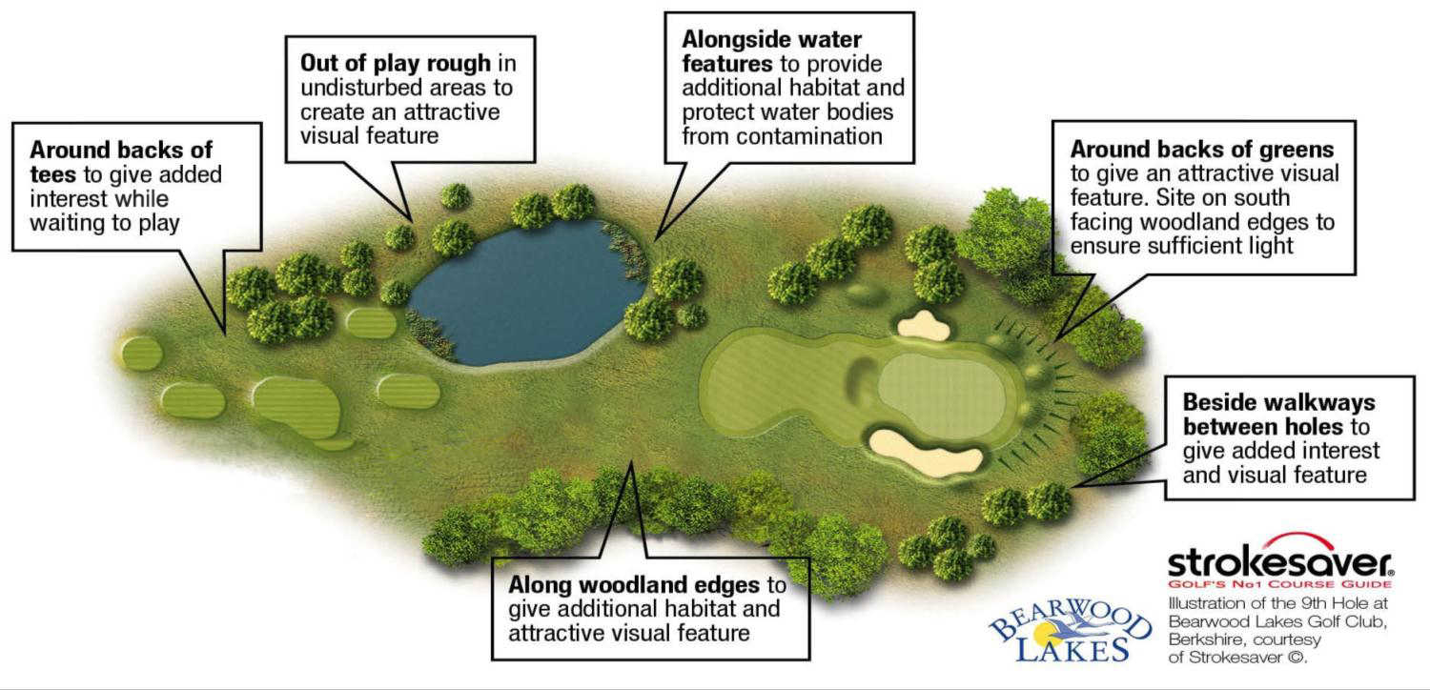
Suitable High Impact Areas

Slide 19
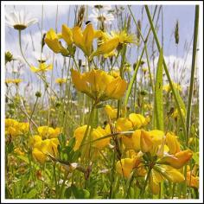
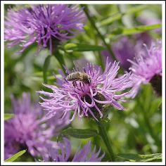
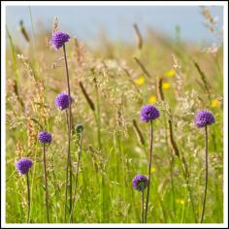
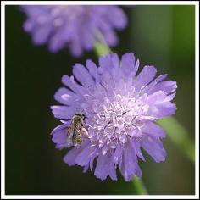
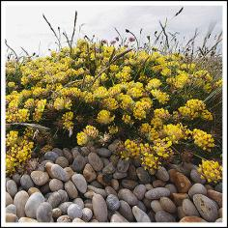
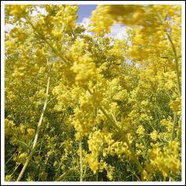
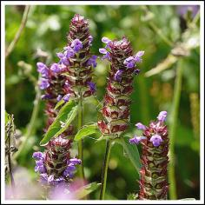
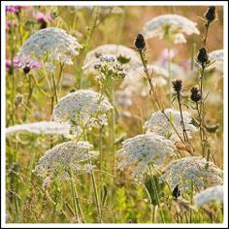
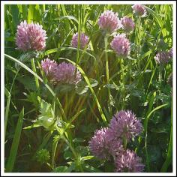
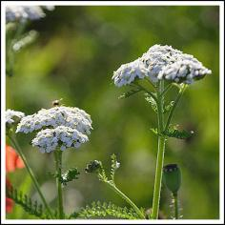
Add Color and Interest
Birdsfoot Trefoil
Black Knapweed
Devil's Bit Scabious
Field Scabious
Kidney Vetch
Lady's Bedstraw
Selfheal
Wild Carrot
Wild Red Clover
Yarrow
Native seed from Applewood Seed Co., Arvada, Colo. Contact: Diane Wilson (303) 431-7333

Slide 20
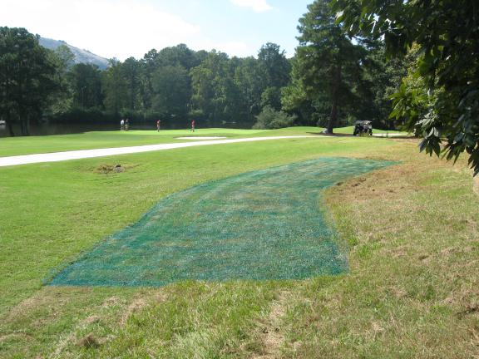
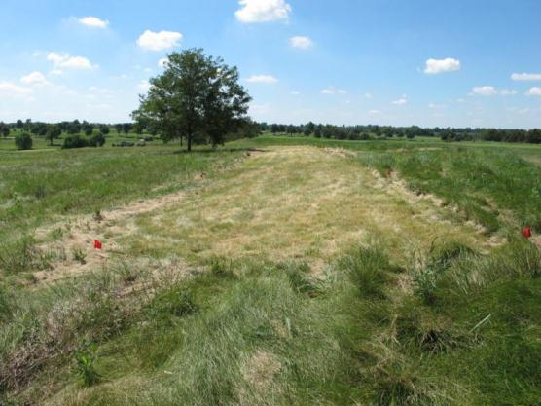
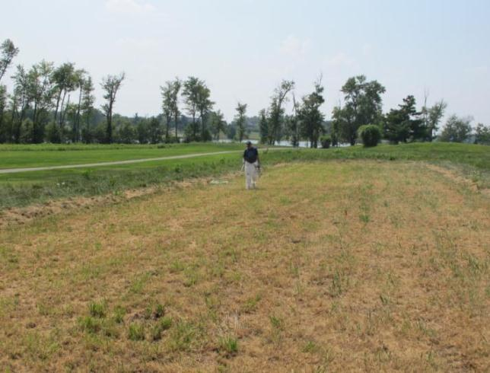
Examples of Plot Establishment
Step 1:
Identify Plot Location
Step 2: Mow
Step 3:
Spray a burndown application

Slide 21
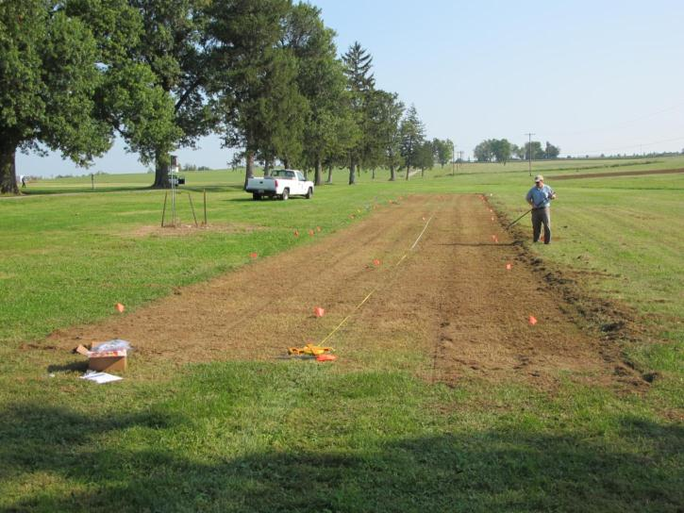
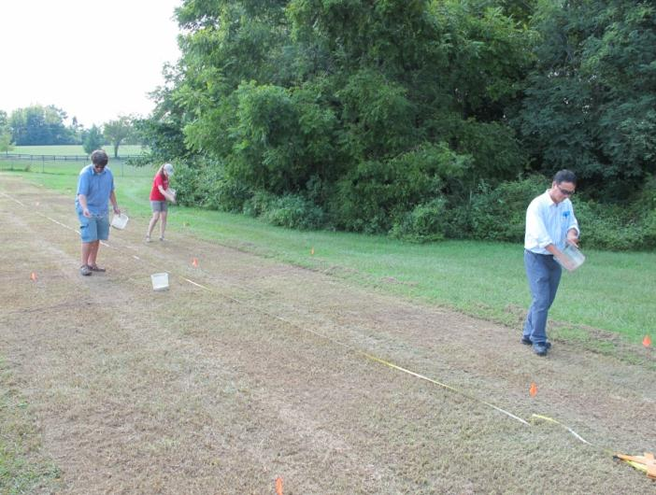
Plot Establishment
Step 4: Rake
Step 5: Seed

Slide 22
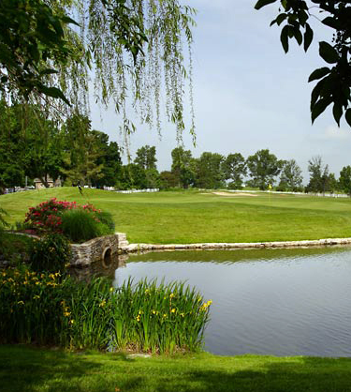
Syngenta & Marriott Golf Commitment to the Environment and Pollinators
Operation Pollinator is a long term collaboration that will serve as a public reminder of our commitment to the environment and pollinators.
Marriott Golf has established and continues to maintain the Operation Pollinator sites.
Syngenta provides know-how on Operation Pollinator establishment and maintenance and will supply the signage.
Possibility of involving local middle school and high school students to monitor the pollinator populations. This is a great way to share the pollinator story and create the opportunity to introduce the next generation to the game of golf.

Slide 23
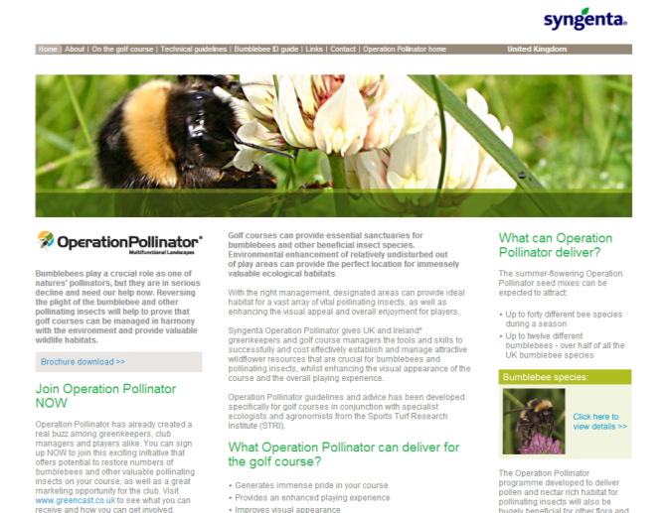
Operation Pollinator Tools
Regular digital communications
www.operationpollinator.com
Literature
Bee ID cards and poster
Web training
Share experiences and feedback results
Downloadable communication materials
www.operationpollinator.com/golf

Slide 24
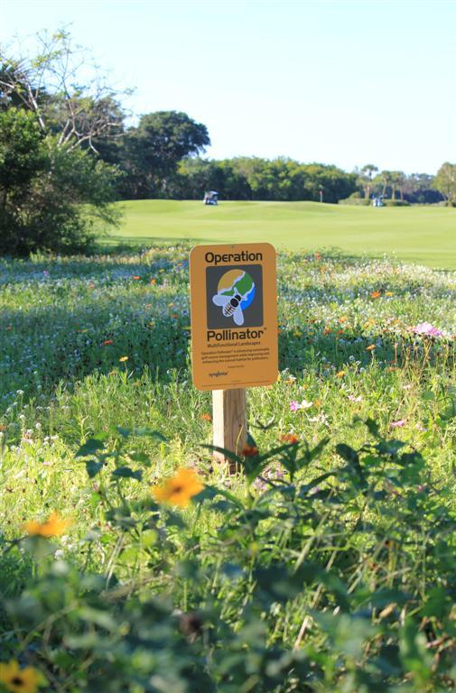
Leadership and Support for the Golf Industry
Operation Pollinator Signage
Container Recycling Program
40+ Territory and Technical Managers
GCSAA Gold Partner
NGCOA Partner and Sponsor
EcoMeasures™ Tool for Carbon Footprint measurement
TurfNet Superintendent of the Year
Syngenta Business Institute™
Established Operation Pollinator site

Slide 25
©2014 Syngenta. Important: Always read and follow label instructions. Some products may not be registered for sale or use in all states or counties. Please check with your state or local Extension Service to ensure registration status. EcoMeasures™, Operation Pollinator®, Syngenta Business Institute™, and the Alliance Frame are registered trademarks of a Syngenta Group Company. Syngenta Customer Center: 1-866-SYNGENT(A) (796-4368).

Slide 26
Appendix

Slide 27
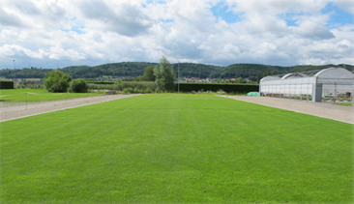
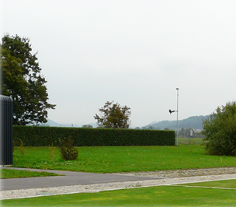
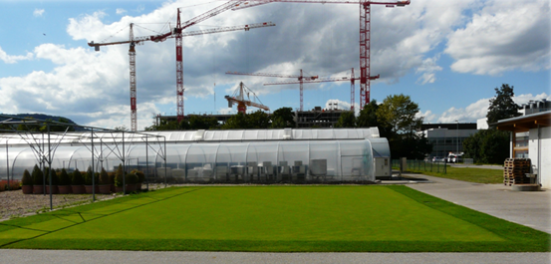
Turf Field Research in Stein
Turf Controls Research team is currently establishing operation pollinator golf site in Stein, Switzerland
Seed mixtures blended entirely from Swiss sourced seed stocks of native wildflowers.
Four turf species sport field and fairway
Operation Pollinator site
USGA golf green

Slide 28
Butterfly
Agastache foeniculum, Lavender Hyssop
Allium cernuum, Nodding Pink Onion
Asclepias tuberosa, Butterfly Milkweed
Cassia hebecarpa, Wild Senna
Coreopsis lanceolata, Lance-Leaved Coreopsis
Dalea purpurea, Purple Prairie Clover
Desmanthus illinoensis, Illinois Bundleflower
Echinacea purpurea, Purple Coneflower
Eryngium yuccifolium, Rattlesnake Master
Liatris spicata, Gayfeather
Rudbeckia hirta, Black-Eyed Susan
Solidago rigida, Rigid Goldenrod
Verbena bonariensis, Purpletop Verbena
Verbena stricta, Hoary Vervain
Veronicastrum virginicum, Culver’s Root
Zizia aurea, Golden Alexander
Simple Bee
Aquilegia canadensis, Eastern Columbine
Coreopsis lanceolata, Lance-Leaved Coreopsis
Echinacea purpurea, Purple Coneflower
Monarda fistulosa, Bergamot
Ratibida columnifera, Prairie Coneflower
Rudbeckia subtomentosa, Sweet Black-Eyed Susan
Symphyotrichum novae-angliae, New England Aster
Tradescantia ohiensis, Ohio Spiderwort
Diverse Bee
Agastache foeniculum, Lavender Hyssop
Aquilegia canadensis, Eastern Columbine
Asclepias tuberosa, Butterfly Milkweed
Coreopsis lanceolata, Lance-Leaved Coreopsis
Coreopsis tinctoria, Plains Coreopsis (annual)
Echinacea purpurea, Purple Coneflower
Echinacea tennesseensis, Tennessee Purple Coneflower
Eryngium yuccifolium, Rattlesnake Master
Gaillardia pulchella, Annual Gaillardia (annual)
Helianthus annuus, Wild Sunflower (annual)
Monarda fistulosa, Bergamot
Penstemon digitalis, Smooth Penstemon
Ratibida columnifera, Prairie Coneflower
Rudbeckia subtomentosa, Sweet Black-Eyed Susan
Symphyotrichum novae-angliae, New England Aster
Tradescantia ohiensis, Ohio Spiderwort
Zizia aurea, Golden Alexander

Slide 29
New Initiative for Golf
Introduce native wildflowers to attract bees and other pollinating insects to out-of-play areas of the golf course
“The quality of the greens and course remains the key factor, but the extra pleasure of playing in a natural environment and having been part of an initiative to encourage wildlife, makes it all the better.”
Phil Cottier, John O’Gaunt Golf Club

